Slide 1

Credentialing System
Stefana Rusu, Devon Fairman, Tyler Palmer

Slide 2
Introduction - Devon
Project Information
Credentialing and Scheduling
Scope
Create more efficiency
Deliverables
Database
MVC App
Technical Document
Testing Plan
Deployment Plan
Team qualifications
Computer Science Majors
Wide variety of experience
Notes:
Notes:
Experience:
C#
SQL
MVC
Project Management
Research & Analysis

Slide 3
Final Status Report
Review of Project
Beginning
End
High-Level Status
Sprint 7
Overall
Detailed Status
Sprint 7
Overall
Risks
Critical
Mitigation
Reflection
Challenges
Triumphs
Issues
Open issues
Error Log
Technical Documentation
High Level
Error Handling
Conclusion
Notes:
Make additional slides for the above information.

Slide 4

Project Recap
Beginning
Strong start
ERD focus
Regular team meetings
Regular stakeholder meetings
End
Moderate finish
MVC Focus
48.65% of use cases functional
16.22% of use cases partially complete (database only)
Implementation incomplete
Thorough documentation

Slide 5

High Level Status
Sprint 7
Updated Database
Updated MVC
Updated Technical Document
Updated Test Plan
Updated Analytical Report
Overall
Completed 77.78% (56/72) of the tasks for the project
Completed 69.69% (410.5/589) of the hours for the project
Negative trends have fluctuated
Notes:
Negative trends have varied. A negative trend that has followed us to the end of the project is the fact that we were not able to complete all the use cases. There are still various tables and stored procedures that have not been implemented in MVC.

Slide 6
Detailed Status
Sprint 7
Updated stored procedures (Qualifications, Instructors)
Updated MVC
Layout and color scheme
Implemented error handling for all current models
“SharedError” view
Finalized Analytical Report, Test Plan, Technical Document
Overall
Created a solid data model (ERD)
Created a solid plan and documentation
MVC app is functional but incomplete
Certain errors have been found but time did not allow for fixing them
Project ready for next team
Notes:
Updated MVC - a “sharedError” view was created to display an error page - instead of each controller having its own Error view, all the controllers redirect to it if an error occurs
Finalized Analytical Report, Test Plan, Technical Document
Analytical report contains high-level information about the project (SWOT analysis, use case diagrams) - everything needed to get familiar with the project.
Technical Design document contains detailed status about the project, the definitions for certain ERD choices and tables, and the processing logic for the MVC app and error handling
Test Plan contains testing for certain features such as Add Course, Update Campus, and Search Room.
Created a solid data model (ERD) that future teams can utilize and continue building upon the project
Certain errors have been found but time did not allow for fixing them - they have been logged with details

Slide 7
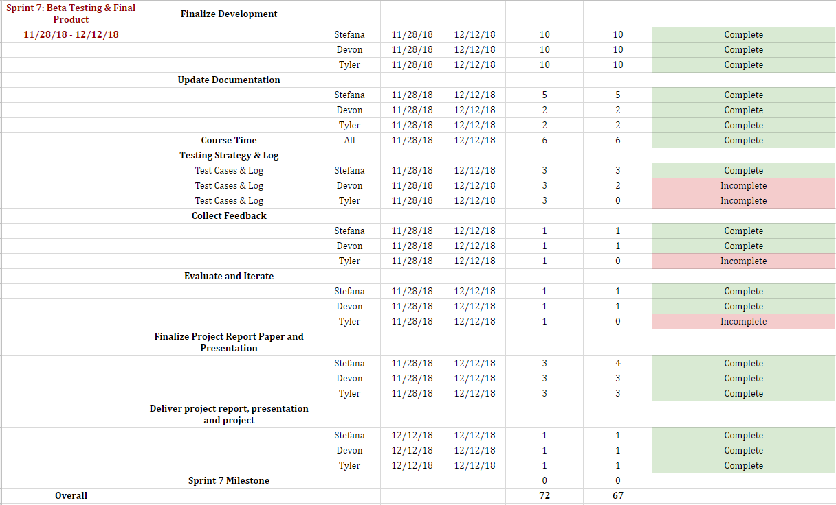
Sprint 7 Tasks

Slide 8
Risks
Critical Risks
Estimation and Scheduling
Growth in Requirements
Conflicting Requirements from Stakeholders
Scope Creep
Mitigation
Research
Stakeholder prioritization/compromise
Consequences
Project completion (incompletion)
Milestone delays
Team member stress
Notes:
Devon

Slide 9

Reflection
Challenges
Requirements
Technologies
Triumphs
Technologies
Documentation
Notes:
Tyler
Requirements - First time doing that kind of requirements gathering.
Technologies - Git, Bootstrap, MVC

Slide 10
Reflection Cont.
What worked?
Source Code Control
Research and Feedback
Organization
What didn’t work?
File Organization
Communication
What would you do differently?
Collaboration
Organization - Trello
UML, Design Plan & Testing
PM Schedule Consistency
Notes:
Tyler
Organization - Google Drive became a mess at one point.
Source Code Control - Git did it’s job.

Slide 11

Issues
Open Issues (link)
ERD Issues
Changing Requirements
Error Log (link)
Issues in the MVC
Database logical error
Package Error
Issues with technology
Notes:
Devon

Slide 12

Technical Documentation
Error Handling
Global error handling
ModelInquire generic
Data access layer returns a model of that type (Room, Campus, etc)
Contains status code
Contains status description
Transition Plan
Thorough Technical Documentation
Access to all other documentation
SWOT analysis
ERD
Final Report
Testing Data
Testing Plan
Were able to check off use cases off the list
Future template for other teams taking over
Contains info about testing strategy
Contains test cases
Testing data
Notes:
The ModelInquire class is built to facilitate error handling. Data access layers will return this, containing the model of a specific type (single object, list, etc.) along with a status code and status description.
For models that return a list, a negative status code will return specific error messages while positive status code will signify the number of records found.
For models that return a single object, negative numbers will return a specific error message, 0 will signify that no record was found, and greater than 1 will signify that multiple records were found for the search criteria.

Slide 13
Conclusion
Notes:
Tyler

Slide 14

Demo
Course Add
Building Update
Room Search

